Slide 1
Topics
Virtual Meeting Best Practices
Virtual Engagement Activities
Tips to Avoid Burnout

Slide 2
Frame yourself wisely
Maintain a strong voice
Don’t become your own distraction
Focus on your camera, not your colleagues
Use the chat window
Be present and mindful
Notes:
Direct eye contact is a vital way to reinforce your point. In a video conference, this means looking into the video camera. Practice looking into your camera during video conferences when you speak, even for brief moments. The more you use it, the more comfortable you’ll become with it.
Using a loud voice will also keep you from mumbling and from speaking too quickly due to the amount of breath required
If your head is cut off at the top or bottom, you’re too close. If your entire torso is in view, you’re too far away. If only half of your head is in sight, please adjust the camera. Also be mindful of your background. Cluttered rooms make communicators seem disorganized.
Remember to use your hands, face and body when you talk on camera – let the audience see you. It add impact to your presentation / information – don’t be just a talking head!
Even if you don’t need to be fully engaged in the meeting, your professional reputation can suffer if it even looks like you’re not paying attention. So close those other windows, turn your phone upside down, MUTE IT, and remember that you’re always “on camera.”
Start by training yourself to stay on mute whenever you’re not speaking and unmuting yourself only when you do speak. Staying on mute shuts out sudden noises as well as routine noises you may not be aware of, like the ticking of a wall clock, the clickety-clack of your typing, or even your own breathing. Also, please practice turning the mute button on and off quickly – don’t be one of those people who has to say – “Oh, sorry I was on mute!” Make sure to turn off your camera when you’re doing something visually distracting as well, such as moving to another room or eating. (Drinking is not very distracting, but chewing is another story) But, please don’t be one of those “casual drinkers” who holds a cup all the time or has one on camera, then you sip your tea. It make you look too casual – this is work! If you are thirsty – drink before or after the call. Don’t be worried about or embarrassed by spontaneous distractions. However, if you’re tasked with giving a major presentation, try to have someone supervise them in another room, far from the temptation of your presence, or at least create an engrossing activity for them.
When you refer to an article or shared document, link to it in the chat. If you run the meeting, put a link to the agenda in the chat. When others are speaking, respond with support or questions in the chat. The chat window is a unique opportunity in virtual meetings to elevate your presence, add dimensions to your ideas, and demonstrate that you’re fully present. And if you are presenting, consider having a coworker monitor Chat and play a participant, so they can alert you to technical issues and field questions while you present.
Source: https://hbr.org/2020/04/how-to-elevate-your-presence-in-a-virtual-meeting?utm_source=feedburner&utm_medium=feed&utm_campaign=Feed%3A+harvardbusiness+%28HBR.org%29

Slide 3
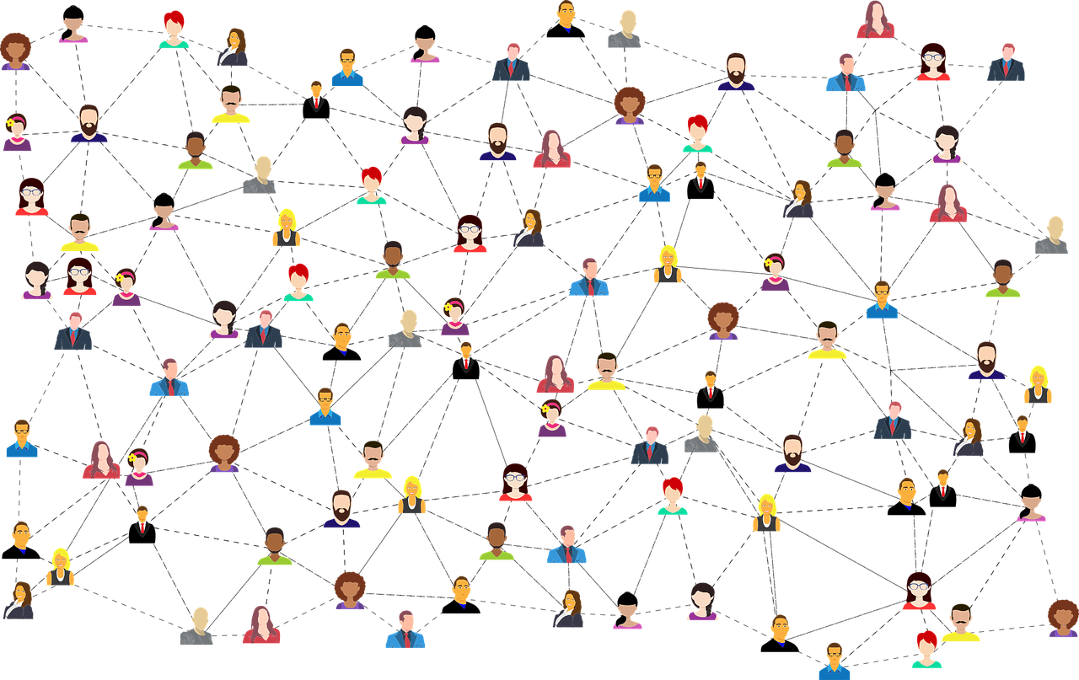
Notes:
Be an active community building. Build a large, active employee community by having regularly schedule events – weekly updates, lunch and learns, online videos, games, etc. This is a great way to get people engaged, see how people are doing, what issues they have and discover what help they need.
Also use your community to offer recognition to folks who have accomplishments – give them praise in front of the community.
Share your stories – during these difficult times, everyone want to be heard. So, listen AND share. Let people into your inner circle to demonstrate you care about them.
Great teams are built by great individuals who have a common challenging experience. With Technology today, everyone can be a filmmaker. Leverage that technology and include some videos. Have your community share important videos they found online, or, better yet, have them make a video about a specific topic then share that with the group. (One important note, however, you might want to have a pre-view of all videos before they are shown, to make sure all videos are appropriate for the group.)
Finally, ask your community to bring others into the community – a large community should be a growing community. New member could include: other departments that relate to yours, other locations or facilities outside your area, outside contacts or personal friends. Have the community bring in people who would add value to the community.

Slide 4
Virtual Engagement Activities
Personal Board
Virtual Lunch
Chats & Message boards
Praise
Video
Notes:
Activity: break into small groups, share success stories, and then report back to the larger group. We can record all of the responses and offer a "top 10 list" or something similar for people to take away from the meeting and try at work. We can then connect that to the community connection message board to ask what did people tried, and to share successes.
1) Personal Board - The facilitator provides a template with various topics (favorite food, drink, movie band, etc. as well as a pic of their WAH office, pets, etc.). The team then has to guess which person belongs to those pics.
2) Virtual Lunch - Grab lunch, turn the camera on, and just talk about whatever. We did a virtual Oaks lunch and it was very well received
3) Chats/Messageboards/praise - we use teams to collaborate, and offering praise badges to coworkers has helped keep people engaged. Since people can't see your face - it is another way to show people you appreciate their contribution
4) For a co-worker work anniversary, we all recorded a short phone video. One person put them together and posted on youtube - this was a big success!

Slide 5
1)
2)
3)
4)
5)
6)
7)
8)
9)
10)
11)
12)
13)
14)
15)
16)
17)
18)
19)
20)

Slide 6
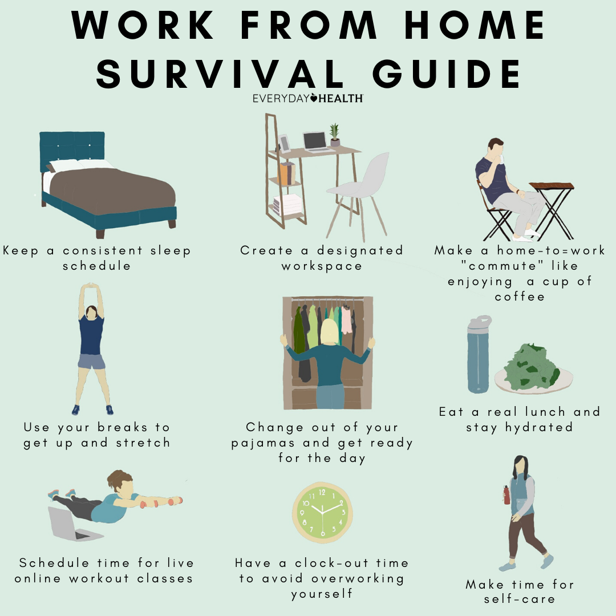
Tips to Avoid Burnout
1. Keep a Consistent Sleep Schedule
2. Carve Out a Designated Workspace
3. Maintain physical and social boundaries
4. Maintain temporal boundaries as much as possible
5. Focus on your most important work
6. Change of scenery (Build Breaks Into Your Schedule)
7. Stop Working
8. Make an Appointment for You Time
Notes:
The lines between work and non-work are blurring in new and unusual ways, and many employees who are working remotely for the first time are likely to struggle to preserve healthy boundaries between their professional and personal lives. To signal their loyalty, devotion, and productivity, they may feel they have to work all the time. Afternoons will blend with evenings; weekdays will blend with weekends; and little sense of time off will remain.
research suggests that drawing lines between our professional and personal lives is crucial, especially for our mental health.
Our research has shown that workers often unintentionally make it hard for their supervisors, colleagues, and employees to maintain boundaries. One way they do so is by sending work emails outside office hours. In five studies involving more than 2,000 working adults, we found that senders of after-hours work emails underestimate how compelled receivers feel to respond right away, even when such emails are not urgent.
transition from work to non-work roles via “boundary-crossing activities.” Putting on your work clothes, commuting from home to work—these are physical and social indicators that something has changed. You’ve transitioned from “home you” to “work you.” Put on your work clothes every morning—casual Friday is fine, of course, but get yourself ready nonetheless. And consider replacing your morning commute with a walk to a nearby park. Meditate, exercise
2) Sticking to a 9-to-5 schedule may prove unrealistic. Employees need to find work-time budgets that function best for them. They also need be conscious and respectful that others might work at different times than they do. For some it might be a child’s nap, for others it might be when their partner is cooking dinner. Employees with or without children can create intentional work-time budgets by adding an “out of office” reply during certain hours of the day to focus on work. A less-extreme reply might be to just let others know that you might be slower than usual in responding, decreasing response expectations for others and yourself.
Creating clear temporal boundaries often depends on the ability to coordinate ones’ time with others. This calls for leaders to aid employees in structuring, coordinating, and managing the pace of work. This might mean regularly holding virtual check-in virtual meetings with employees, or providing them with tools to create virtual coffee or workspaces. Through this disruption, keeping a sense of normality is key.
3) This is not the time for busy work. Workers should be devoting their energy to top-priority issues.
While working from home, employees often feel compelled to project the appearance of productivity, but this can lead them to work on tasks that are more immediate instead of more important—a tendency that research suggests is counterproductive in the long run, even if it benefits productivity in the short run. Employees, particularly those facing increased workloads as they juggle family and work tasks, should pay attention to prioritizing important work. Employees who feel “on” all the time are at a higher risk of burnout when working from home than if they were going to the office as usual. In the long-term, trying to squeeze in work and email responses whenever we have a few minutes to do so —during nap time, on the weekend, or by pausing a movie in the evening—is not only counterproductive but also detrimental to our well-being. We all need to find new ways—and help others do the same—to carve out non-work time and mental space.
Source: https://hbr.org/2020/04/3-tips-to-avoid-wfh-burnout
Exercise, check the mail, get dressed, take a real lunch break away from your desk
Give yourself an evening commute, or use one of the commute replacements we mentioned in the morning.
Plan to check in with your family or friends. I know my kids will be waiting for me. Partners, roommates, or friends can also play this role.
Schedule something right after work, whether that’s a social event or an appointment with yourself for your favorite exercise or hobby.
Source: https://lifehacker.com/structure-your-work-from-home-day-with-these-routines-1823158185
Source: https://www.everydayhealth.com/healthy-living/your-work-from-home-survival-guide-for-self-care/

Slide 7
Create Your Own
Virtual Meeting Best Practices
Frame yourself wisely
Use the chat feature
Maintain a strong, clear voice
Use your entire body when you speak
Focus on your camera lens, not on your colleagues picture
Be present and mindful
Don’t become your own distraction - avoid visual diversions and use the MUTE button like a pro
Know and use the technology well
Build your community
Tips to Avoid Burnout
Keep a consistent sleep schedule
Carve out a designated workspace
Maintain physical and social boundaries
Maintain temporal boundaries as much as possible
Focus on your most important work
Change of scenery (Build breaks into your schedule)
Stop working when it’s time
Make an appointment for your time
Virtual Engagement Activities
Personal Board
Virtual Lunch
Chats & Message Boards
Praise & Recognition
Stories & Videos

