Slide 1
Instructions
Slide 2 illustrates the categories of images to compile to make your “You Board”. Slide 4 illustrates a completed example.
For each category, find images that represent you. These can be photos or images, and can be as creative as you like. You can any number you want. By selecting your images, you not only display your thoughts on the category (categories are provided as suggestions, you don’t necessarily have to use those specific categories), but your personality by how you elect to represent that thought. (Just keep it business appropriate!) Upload or download your images to a drive you can access.
Using slide 3, right click on a box and select ‘Change Picture’. Navigate to your local drive to upload your photo. Repeat for all boxes.

Slide 2
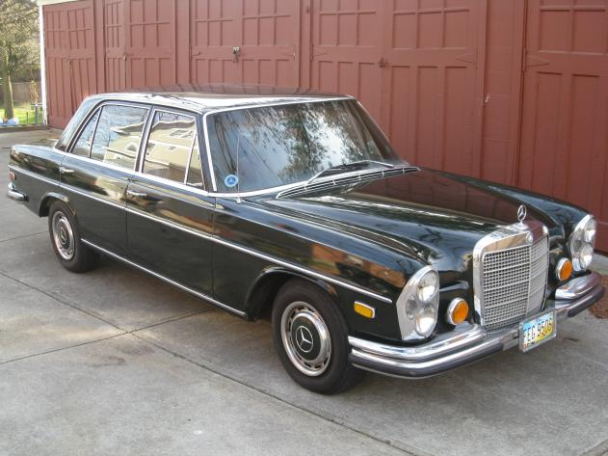
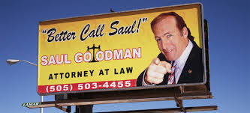
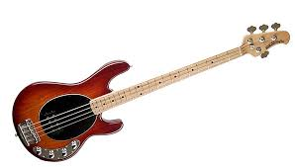
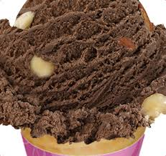
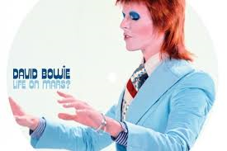
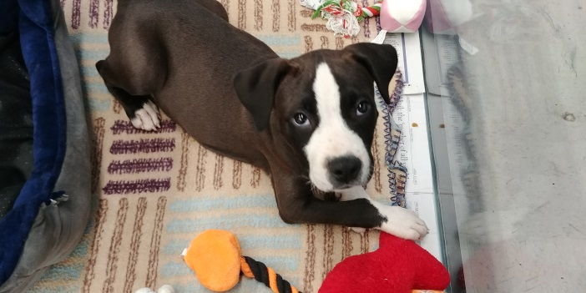
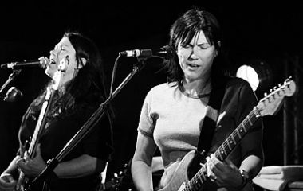
Notes:
Guide

Slide 3
Notes:
Template

Slide 4
Learn More…
Picture | Your Pick | Backstory
Book
Movie
Sports Team
Holiday

Slide 5
Learn More…
Picture | Your Pick | Backstory
Your Car
TV Show
Beverage
Food

Slide 6
Learn More…
Picture | Your Pick | Backstory
Music
Hobby
Ice Cream Flavor
Animal
Your Desk

